Slide 1



In the name of Allah, Most Gracious, Most Merciful.
ENHANCED HUMAN POSE ESTIMATION UNDER OCCLUSION USING GRAPH-BASED OPTIMIZATION TECHNIQUES: A STUDY WITH G2O FRAMEWORK
Submitted By
Shirajul Islam Shakur (C213040)
Alfaz Uddin Emon (C213057)
Md. Mohaiminul Islam (C213067)
Supervisor Mohammad Mahadi Hassan
Assistant Professor,
Dept. of CSE, IIUC
Co - Supervisor
Md. Khaliluzzaman
Assistant Professor,
Dept. of CSE, IIUC
Department of Computer Science and Engineering
International Islamic University Chittagong

Slide 2
INTRODUCTION
We are working on improving human pose estimation, which means detecting body positions in images or videos. Our focus is on solving the problem of occlusion, where body parts get hidden due to objects, movement, or other people. We are using a graph-based optimization method (G2O) to make the estimations more accurate and reliable. This can be useful in fields like healthcare, sports, and animation.

Slide 3
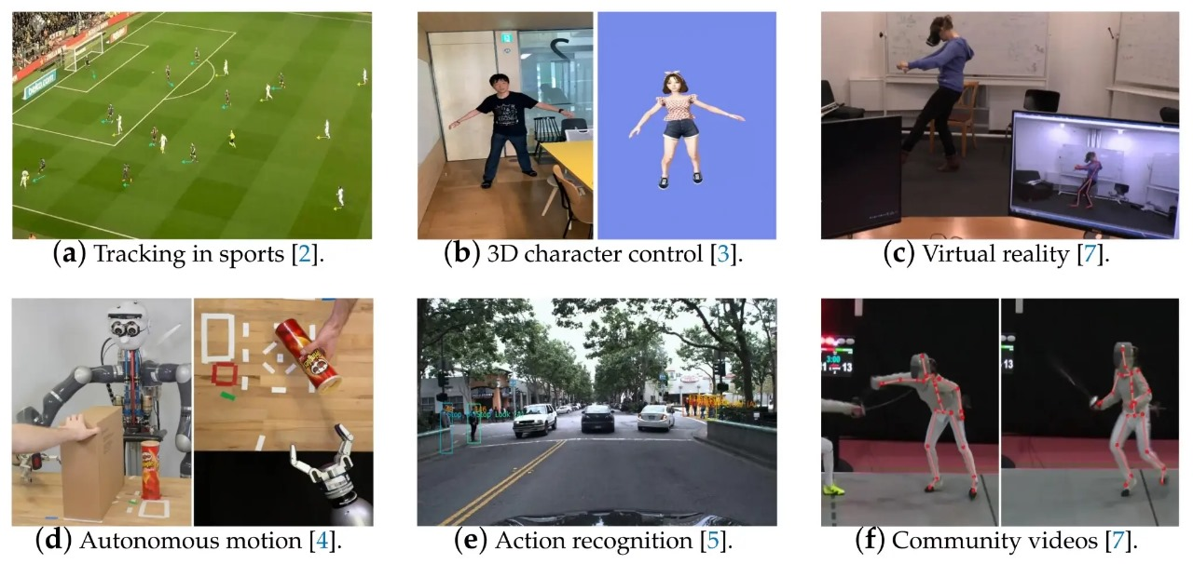
Applications

Slide 4
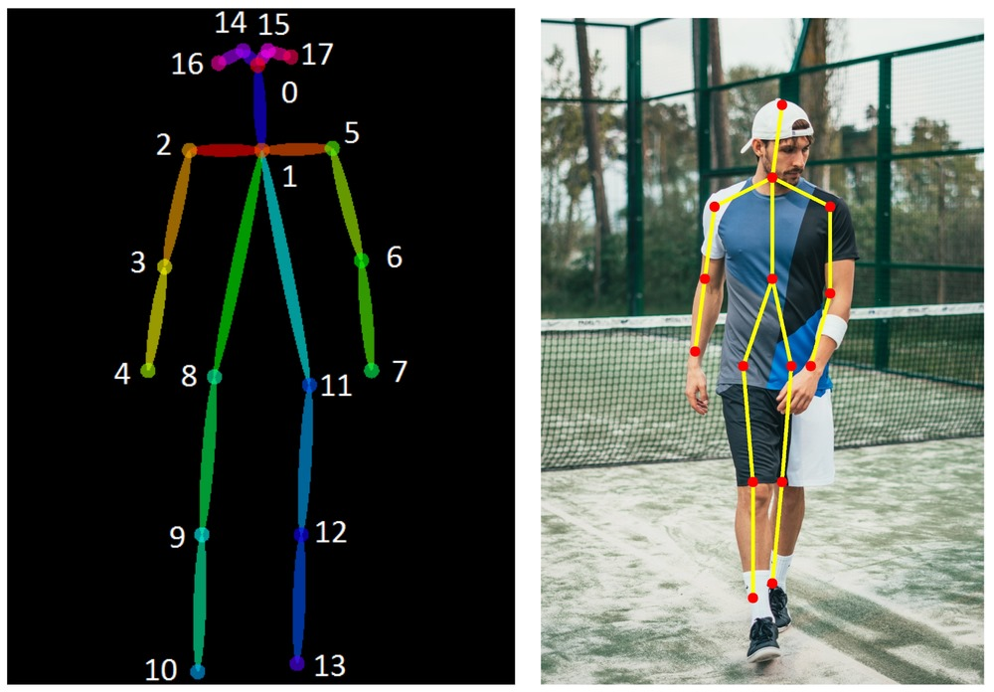
Aim’s & Objectives
Implement G2O framework for human pose estimation.
Develop methods that enhance accuracy under occlusions and noisy data.
Optimize key point relationships using constraints for biomechanical acceptability.

Slide 5
Summary of Literature Review
Ref | Title | Author | Dataset | Methodology | Findings
[1] | Occlusion-Aware Networks for 3D Human Pose Estimation in Video | Yu Cheng, Bo Yang, Bo Wang, Wending Yan, and Robby T. Tan1 | Human3.6M Dataset: This is a large-scale 3D human pose dataset containing 3.6 million images | Filter keypoints via heatmaps/optical-flow; TCNs ensure smoothness/occlusion handling. Train with synthetic occlusions and enforce pose constraints for biomechanical accuracy. | The proposed occlusion-aw are framework improves 3D human pose estimation by effectively handling occlusions, reducing estimation errors, and outperformin g state-of-the-a rt methods.
[2] | g2o: A General Framework for Graph Optimization | Rainer Kummerle, Giorgio Grisetti , Hauke Strasdat ,Kurt Konolige,Wolfram Burgard | Manhattan3500 Dataset, Victoria Park Dataset, Venice Dataset, Scale-Drift Datase | g2o optimizes graph-based nonlinear error functions by leveraging sparse connectivity, advanced solvers, and efficient numerical techniques for SLAM and Bundle Adjustment. | Occlusion Handling & Error Reduction: The occlusion-aware framework improves 3D pose estimation by effectively managing occlusions and minimizing errors. State-of-the-Art Performance: Outperforms existing methods in accuracy and robustness under occlusion scenarios.
[3] | A simple yet effective baseline for 3d human pose estimation | Julieta Martinez, Rayat Hossain, Javier Romero, and James J. Little | HumanEva, Human3.6M-This is currently the largest publicly available dataset for 3D human pose estimation, consisting of 3.6 million images., MPII Dataset | A lightweight feedforward network with residual connections, batch normalization, and dropout maps normalized 2D joint locations to 3D poses in camera coordinates. | A simple deep network lifting 2D joint inputs to 3D significantly reduces error, revealing that 2D detection quality largely drives 3D pose estimation performance

Slide 6
Contd..
Ref | Title | Author | Dataset | Methodology | Findings
[4] | G2O-Pose: Real-Time Monocular 3D Human Pose Estimation Based on General Graph Optimization | Haixun Sun, Yanyan Zhang ,Yijie Zheng, Jianxin Luo * and Zhisong Pan | Training and Testing: Typically, subjects S1, S5, S6, S7, and S8 are used for training, while subjects S9 and S11 are reserved for testing.Depth Considerations | The study presents G2O-Pose, a real-time monocular 3D human pose estimation method using general graph optimization with multiple constraints, including bone proportion recovery, human orientation classification, and reverse joint correction. | G2O-Pose significantly improves running speed while maintaining comparable accuracy to traditional methods, achieving 32 FPS on consumer hardware and outperforming non-deep learning approaches when depth variation is minimal..
[5] | OpenPose: Realtime Multi-Person 2D Pose Estimation using Part Affinity Fields | ZheCao, Gines Hidalgo, Tomas Simon, Shih-EnWei, and YaserSheikh | publicly released annotated foot dataset, which is used to evaluate foot key point detection results , MPII for training and testing, | The methodology involves a bottom-up approach where a feedforward network predicts 2D confidence maps for body part locations and vector fields for PAFs, which encode the association between body parts. The system iteratively refines PAF predictions and confidence maps to output accurate 2D key points for all individuals in the image | The study demonstrates that combining body and foot estimation into a single model enhances accuracy and reduces inference time, while the use of Part Affinity Fields (PAFs) significantly improves runtime performance and accuracy in multi-person 2D pose estimation.
[6] | DSPose: Dual-Space-Driven Keypoint Topology Modeling for HumanPoseEstimation | Anran Zhao ,Jingli Li , Hongtao Zeng, Hongren Cheng and Liangshan Dong | The experiments were conducted using the MPII dataset, which is commonly used for evaluating human pose estimation models | The methodology involves a Transformer-based feature extraction for accurate key point features, integration of physical space correlations to address localization errors, and the use of a graph convolutional neural network (GCN) to fuse spatial and feature correlations for improved pose estimation | The proposed dual-space-driven topology model, DS Pose, achieved competitive results in human pose estimation tasks, outperforming several existing methods on the MPII dataset by achieving four best and four second-best indicators across various metrics

Slide 7
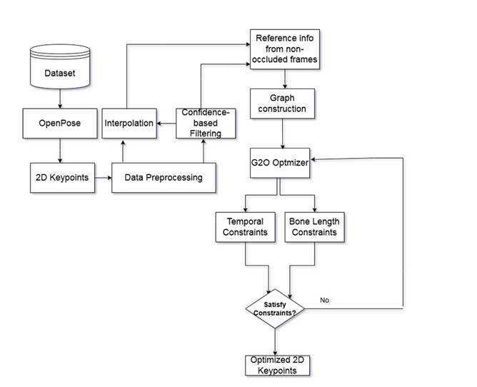
Methodology

Slide 8
Research Gap
Different Occlusion Types: Occlusions can come from objects, other people, or even the person’s own body (self-occlusion). Each type can confuse the model in its own way.
Inconsistent Results: When body parts are obscured, the pose estimation results can be noisy, inconsistent, or even unrealistic, making them unreliable in practical use
Real-World Application Impact: The ability to track human movement accurately in real-world situations, like sports or healthcare, requires overcoming these occlusion challenges to provide better and more reliable results.

Slide 9
Gantt Chart

Slide 10

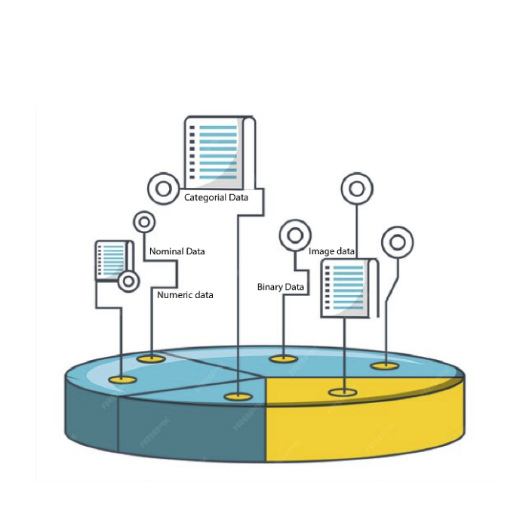

Challenges
Handling Occlusions: When body parts are hidden, current models struggle to estimate poses accurately.
Unreliable Predictions in Videos: When people move and some body parts are hidden, the model often gives wrong results.
Generalization Across Datasets: Variations in camera angles, lighting, and body shapes can impact the accuracy of the model.

Slide 11
Conclusion
This research highlights the advantages of General Graph Optimization (G2O) in human pose estimation. By addressing key challenges such as occlusion and noisy data, G2O enhances accuracy and robustness. The proposed approach ensures that estimated key points adhere to spatial and temporal constraints, resulting in more coherent pose estimations. Additionally, the ability to handle multi-person scenarios and adapt to diverse input conditions expands its applicability across various fields. With reduced computational complexity, the framework is suitable for real-time applications, making it a valuable contribution to the field of computer vision.
11

Slide 12
References
[1] F. Wang, M. Cheng, X. Liu, and J. Luo, “Occlusion-aware human pose estimation using graph-based optimization,” Proceedings of the IEEE Conference on Computer Vision and Pattern Recognition (CVPR), 2022, pp. 401–412.
[2] R. Kümmerle, G. Grisetti, H. Strasdat, K. Konolige, and W. Burgard, “G2O: A general framework for graph optimization,” Proceedings of the IEEE International Conference on Robotics and Automation (ICRA), pp. 3607–3613, 2011.
[3] J. Martinez, R. Hossain, J. Romero, and J. J. Little, “A simple yet effective baseline for 3D human pose estimation,” Proceedings of the IEEE International Conference on Computer Vision (ICCV), 2017, pp. 2659–2668.
[4] X. Zhou, M. Zhu, Z. Deng, and X. Yuan, “G2O-based optimization for monocular human pose estimation,” IEEE Transactions on Image Processing, vol. 31, pp. 1235 1248, 2022. [5] ZheCao, Gines Hidalgo, Tomas Simon, Shih-EnWei and YaserSheikh, ”OpenPose: Realtime Multi-Person 2D Pose Estimation using Part Affinity Fields”, IEEE Transaction on Pattern Analysis and Machine Intelligence,arXiv:1812.08008v2 [cs.CV] 30 May 2019 [6] Anran Zhao, Jingli Li, Hongtao Zeng, Hongren Cheng, and Liangshan Dong,” DSPose: Dual-Space-Driven Keypoint Topology Modeling for HumanPoseEstimation ”, Received: 27 July 2023 Revised: 27 August 2023 Accepted: 1 September 2023 Published: 3 September 2023
12

Slide 13
Assalamu Alikum

